Slide 1
Technology

Slide 2
Development Tools and Testing Tools
Eclipse IDE for Java Developers Version: 2018-09 (4.9.0)
JUnit 4

Slide 3
Development and Testing Platform
a. Mac OS X 10.14.1
b. Windows 10 1607

Slide 4
Documentation
Visual Paradigm Version 15.1 Build 20181103: Sequence Diagrams, Class Diagrams and Use Case Diagrams
Javadoc: Generating Java manual
Bugzilla: Bug report
Microsoft Word: Reports

Slide 5
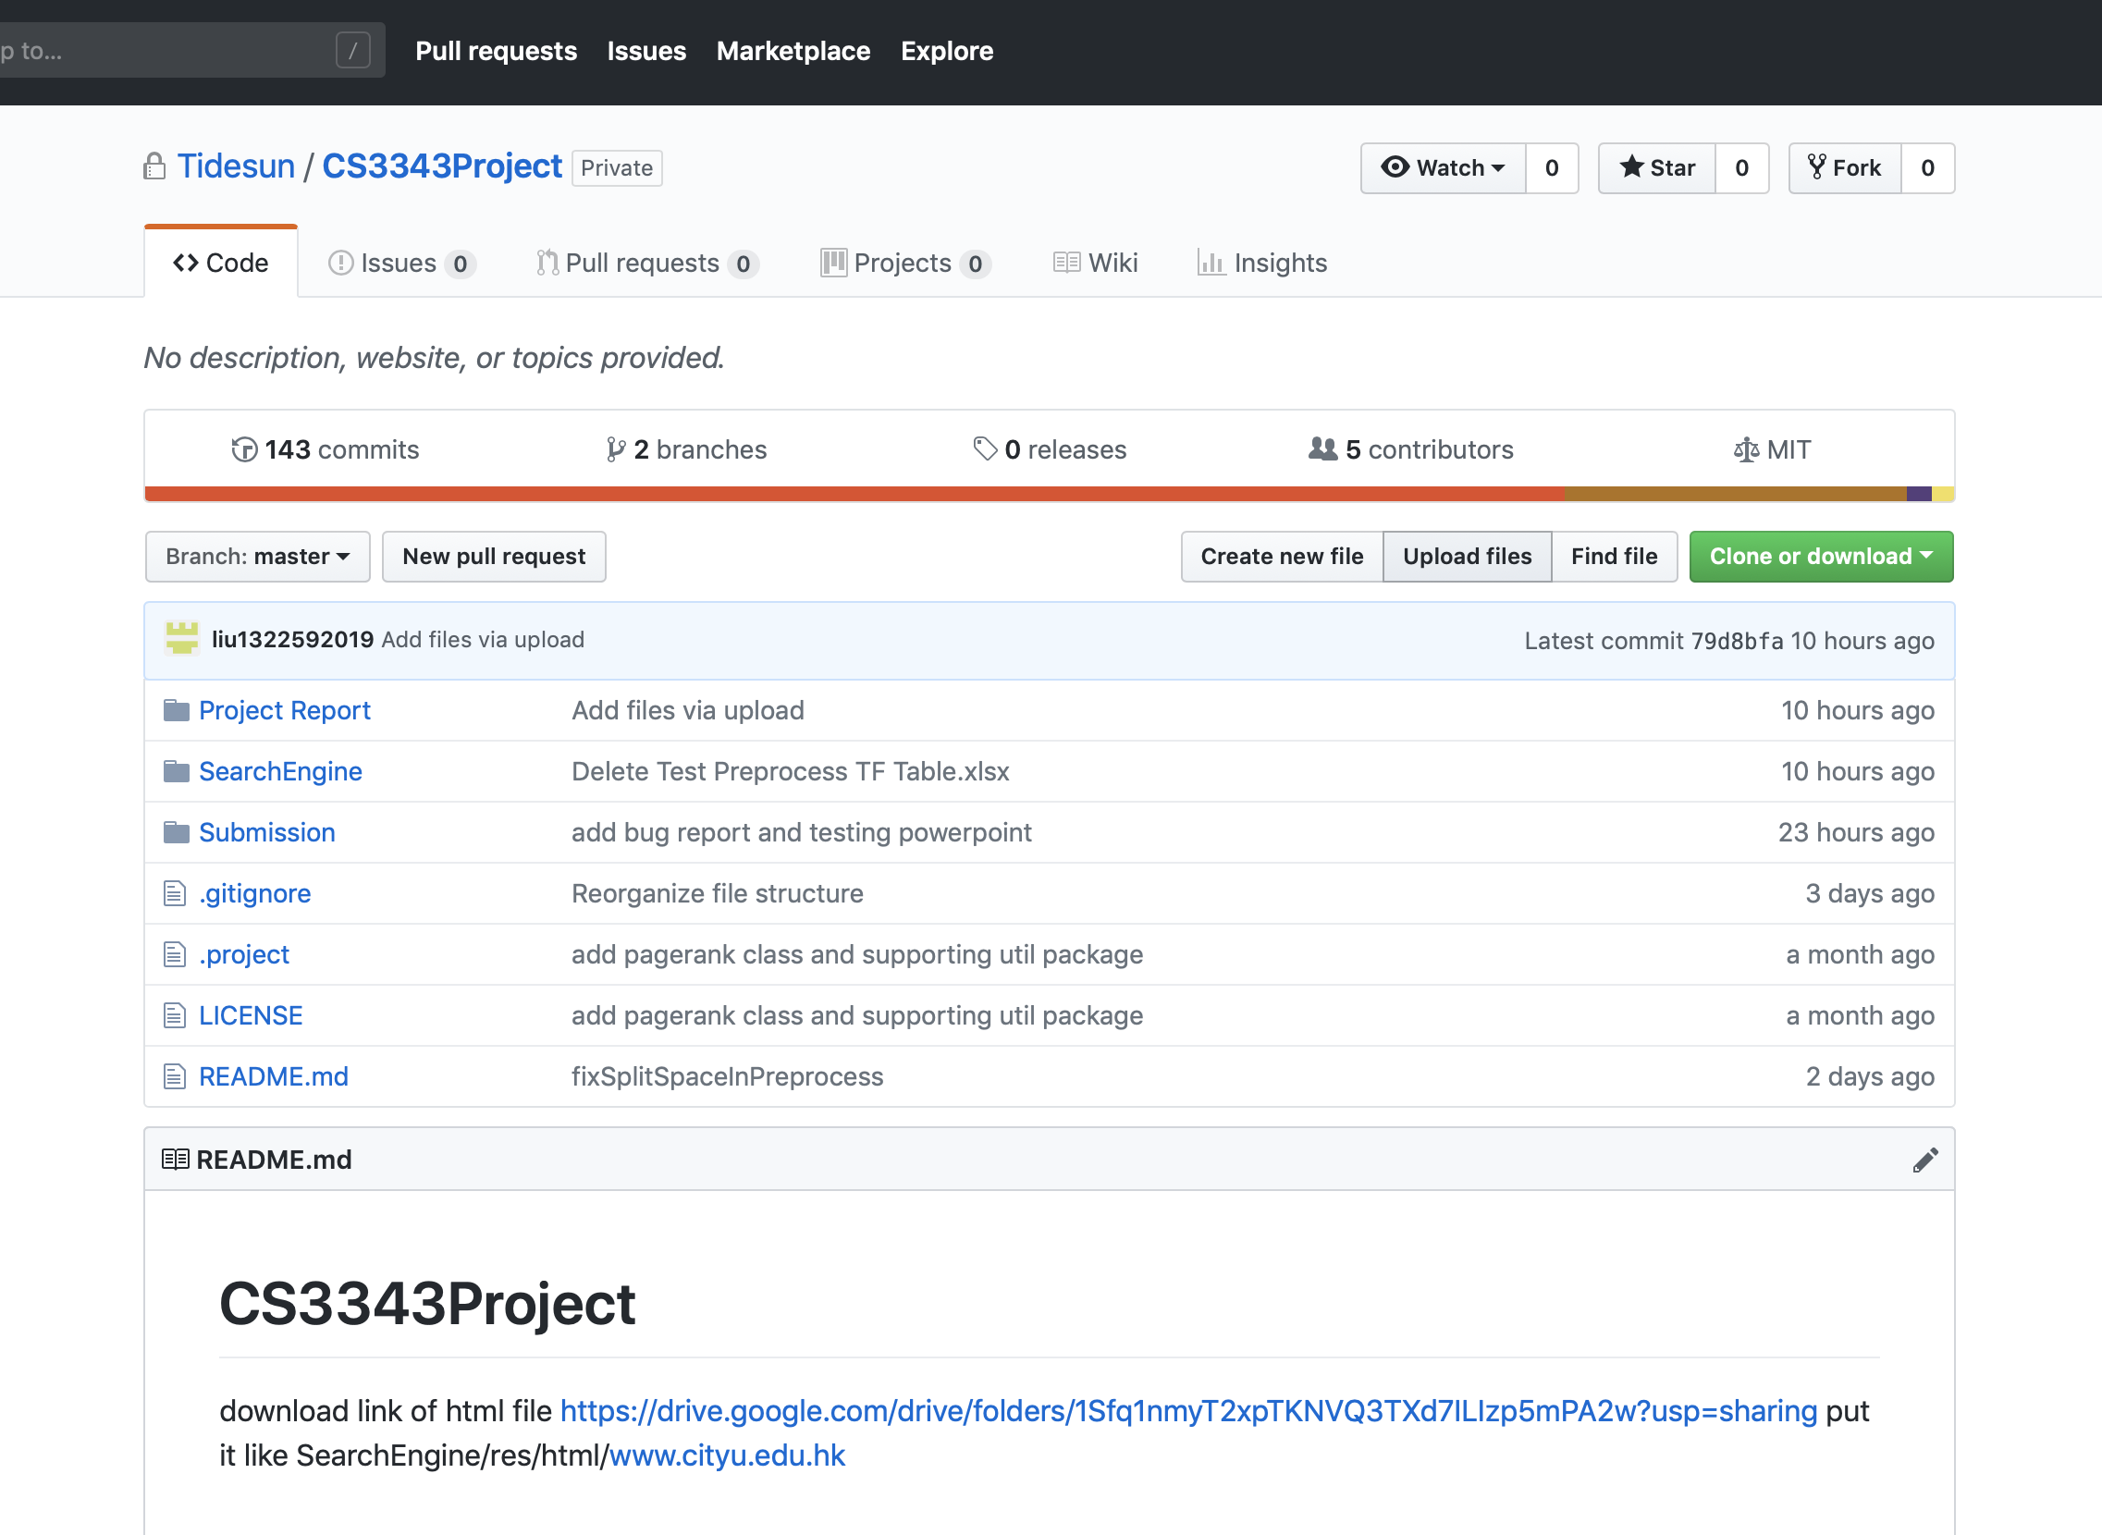
Project Management
GitHub
Hosting various versions of source code
->allows the same team users to cooperate by working on different parts and confirm the schedule of the project.

Slide 6
Demo

Slide 7
Q&A

